Slide 1
The प्राकृतिक way:
Herbal Products
Developed by:
1.Nirav chauhan
2.Manan sharma
3.Saurav mistri

Slide 2
Index
Project Definition
Company Profile
Project Profile
Modules of the system
Tools & Technology
Existing system
Need for the system
Objective of the system
Context level diagram
1st level diagram
2nd level diagram
ER diagram
Data Dictionary
Bibliography

Slide 3
Project Definition
The प्राकृतिक way: Herbal Products is an online user friendly web application for viewing different health care products and also able to place order.
User can also able to give and view feedback and gallery details.

Slide 4
Company profile
Company Name : | Logical Street Technology
Company Website : | www.logicalstreet.com
Company Guide : | Mr. Rajnik Radadiya
Company Address : | Nikol,Ahmedabad
Company Contact : | 7600284160

Slide 5
Project profile
Group No. :18
Group Members :
Nirav chauhan(6019)
Manan sharma(6144)
Saurav s. mistri (6064)
Internal Guide :
Prof. MONA SHAH
External Guide :
Mr. Rajnik Radadiya
Application Type :
Web Application

Slide 6
Users
Admin
Customer(Registered User)
visitor
Delivery boy

Slide 7
1. Admin
Login
Manage Customer
Edit Profile
Manage Category
Manage Sub-Category
Manage Products
Manage Order
Manage Feedback
Manage Gallery
Manage Delivery Boy
Generate Reports
Monthly Best Selling
Logout

Slide 8
2.Customer
Registration
Login
View Category
View Sub-Category
View Products
View Gallery
Place Order
Track Order Status
Payment
Edit Profile
Give Feedback
Logout

Slide 9
3.Guest User
View Category
View Sub-category
View Products
View Feedback
View Gallary

Slide 10
4.Delivery Boy :
Login
View delivery status
Update delivery status
Logout

Slide 11
Tools and Technology :
Front End : PHP 7.1
Back End : MySql 8.0

Slide 12
Disadvantages of Existing System
If user wants to view or purchase different herbal products then need to visit that shop to place order.
User cannot have idea about the new arrival products.
User cannot view the feedback for the new arrival products and services.

Slide 13
Need For New System
This website is provide online herbal products.
User can able to view and search for products in different category.
User can get home delivery and online payment available too.

Slide 14
Objective
The प्राकृतिक way: Herbal Products is an online website for viewing different health care products and also able to place order.
User can give and view feedback to this website.
This system is also give user best selling product so user can get suggestion what best product is in the website.

Slide 15
Data Flow Diagram

Slide 16
Context Level

Slide 17
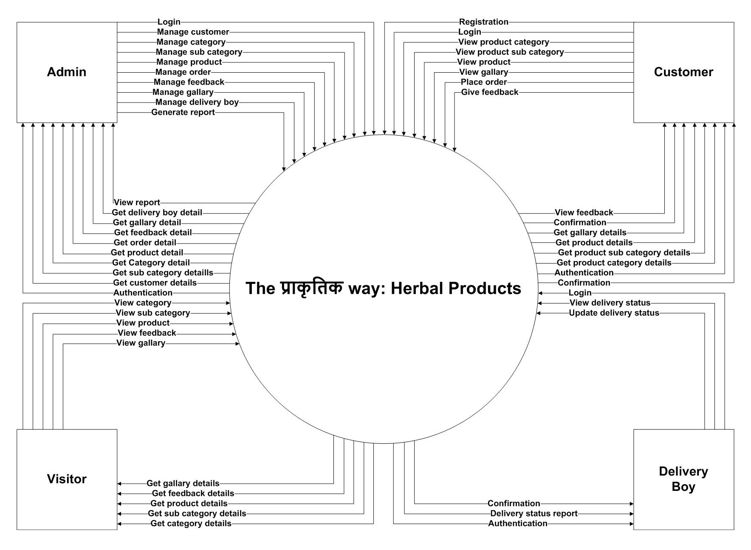

Slide 18
1st Level DFD for Admin

Slide 19
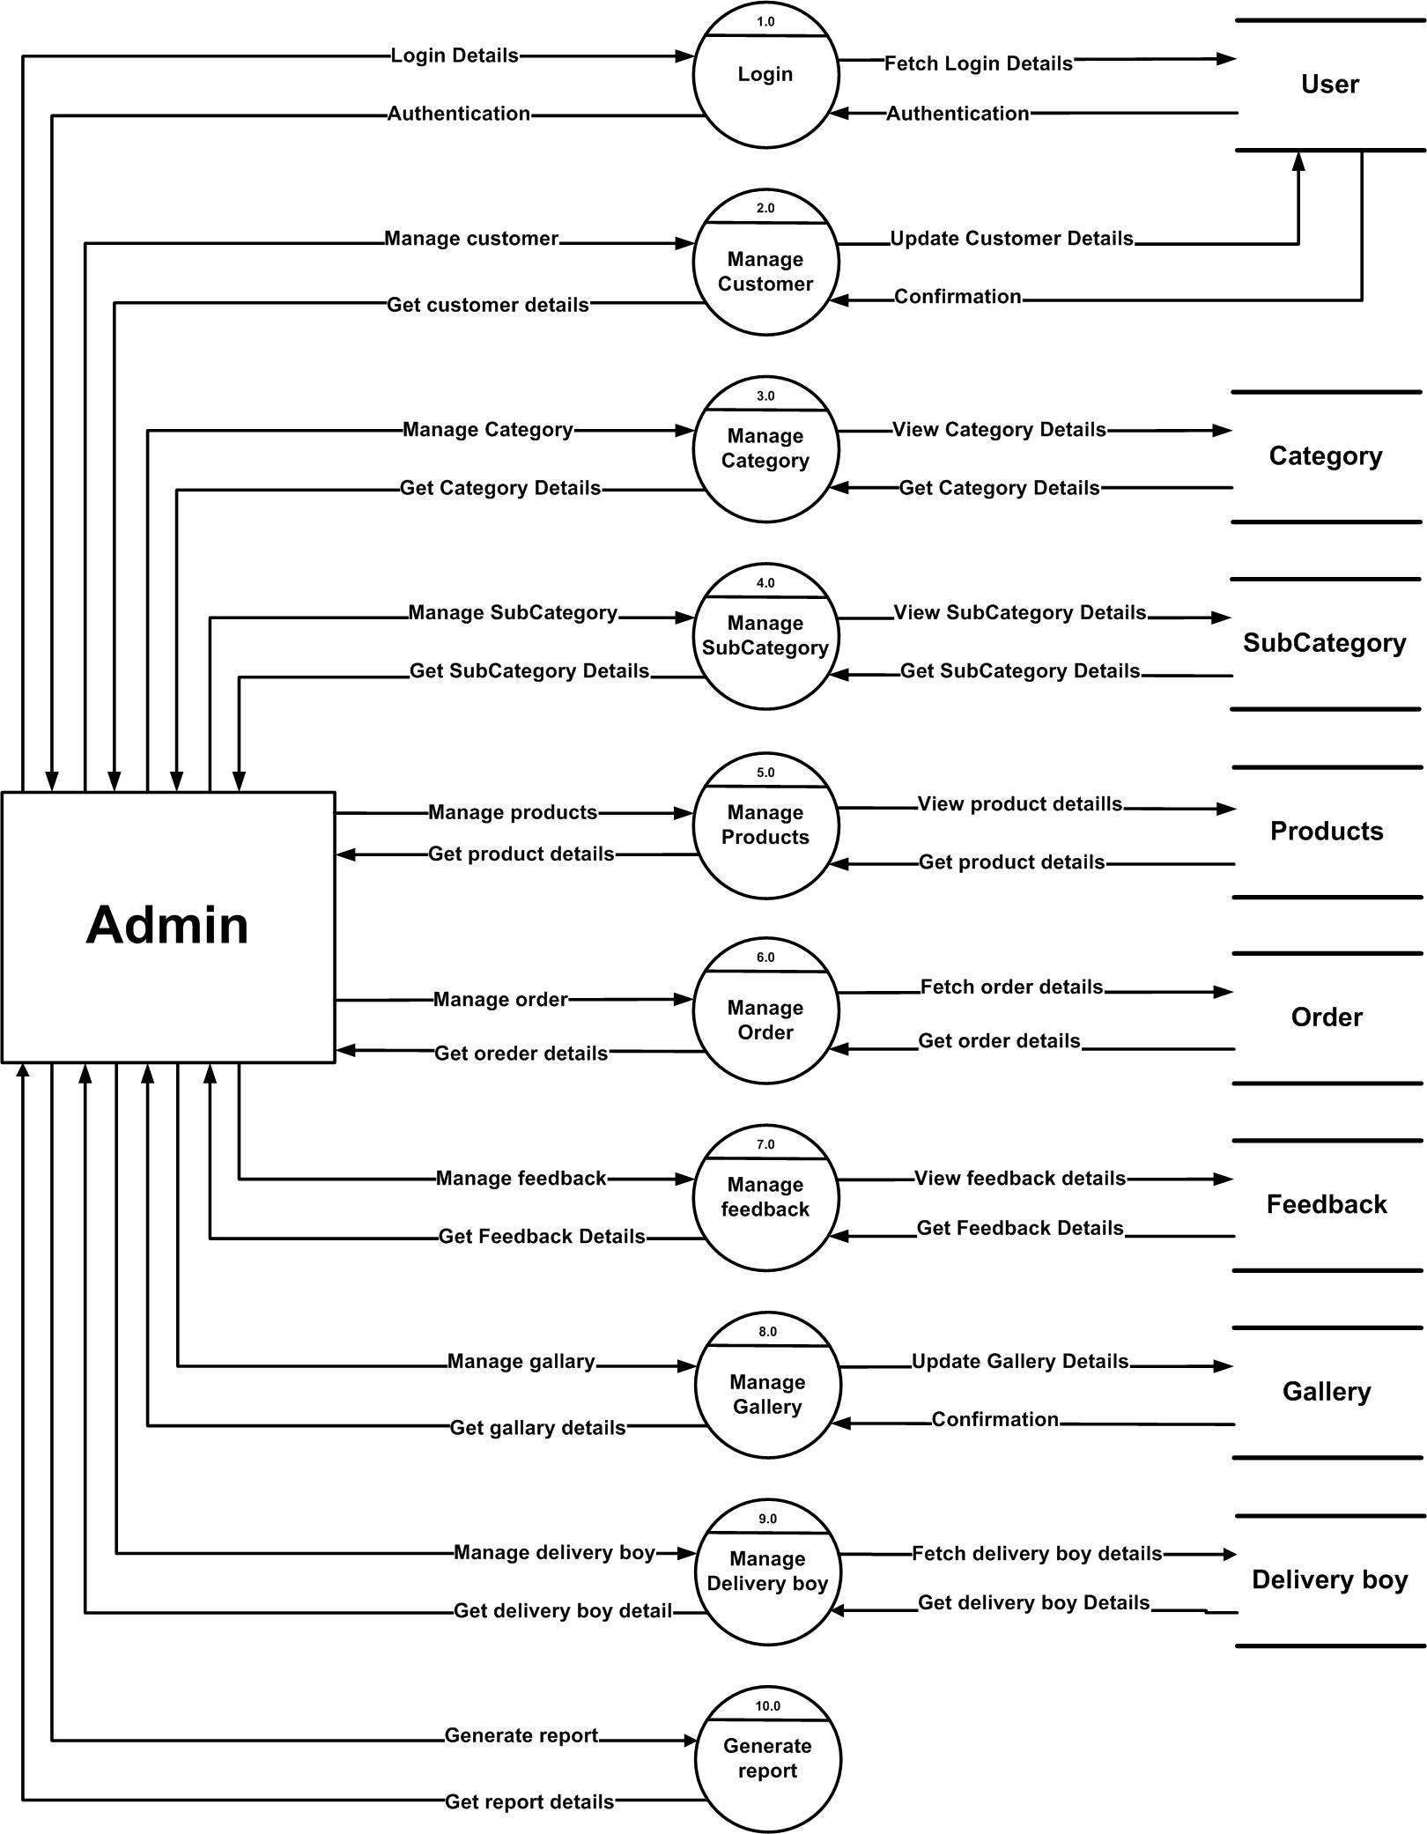

Slide 20
1st Level DFD for Customer

Slide 21
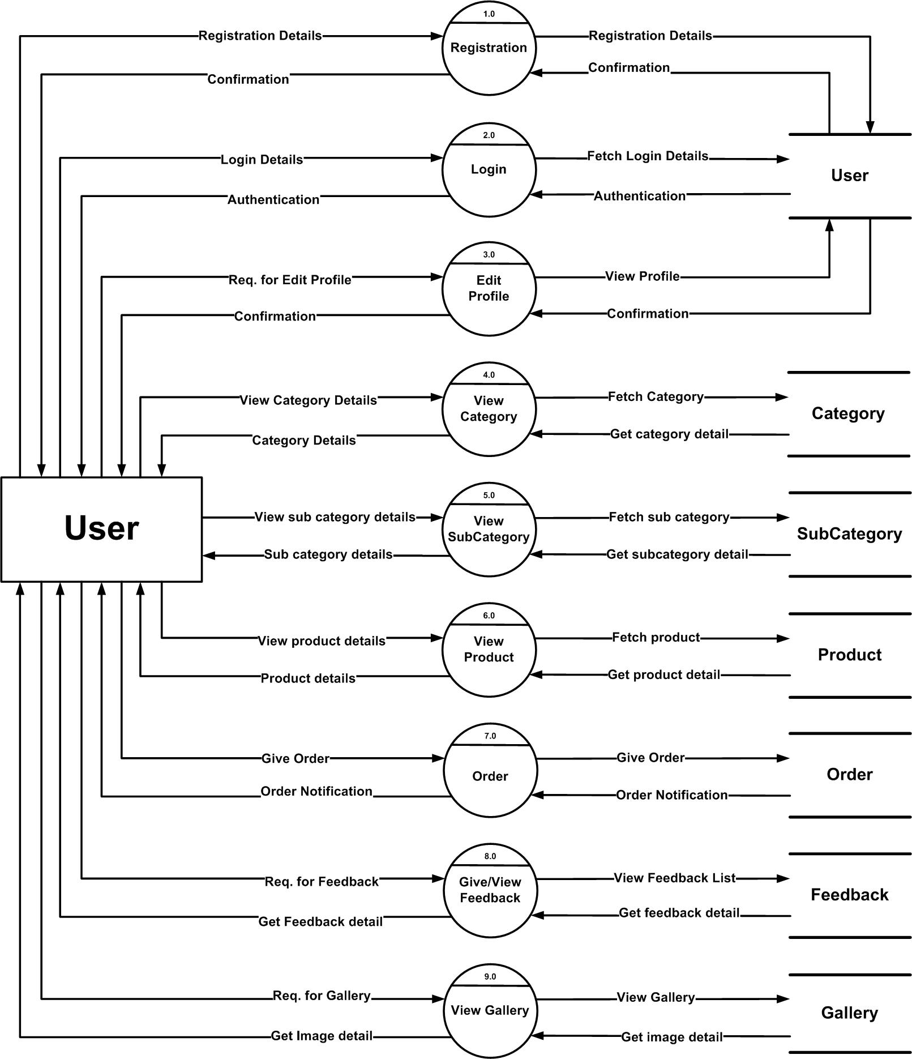

Slide 22
1st Level DFD for Visitor

Slide 23
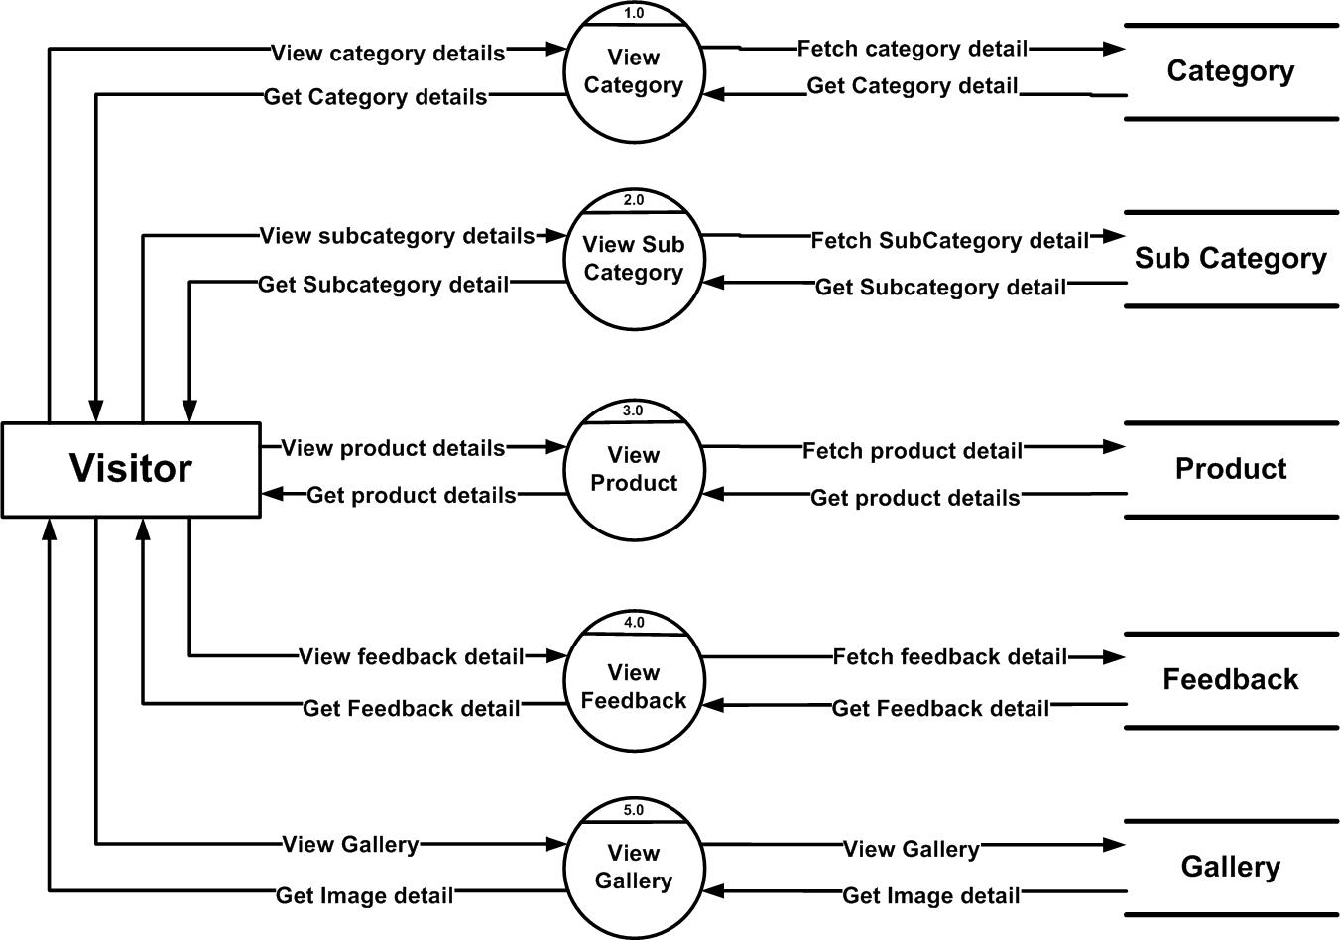

Slide 24
1st Level DFD for Delivery boy

Slide 25
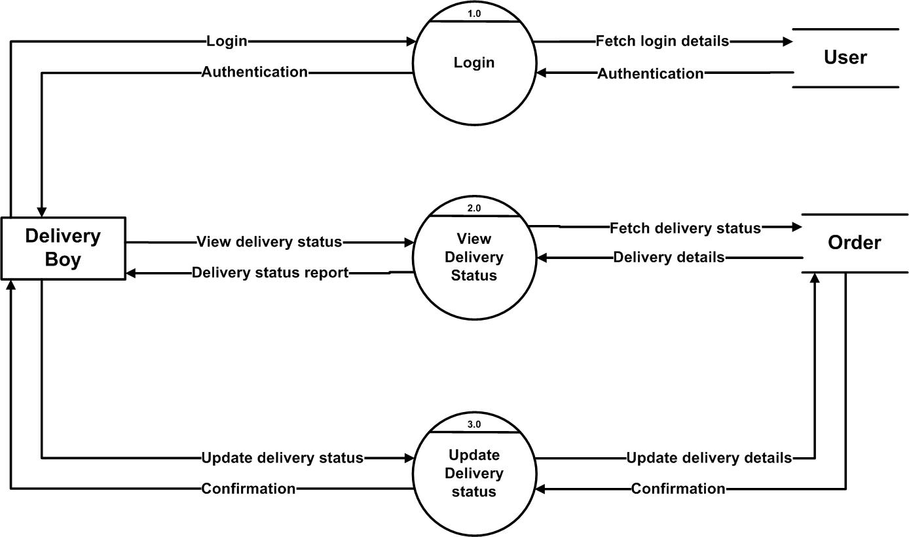

Slide 26
2nd Level DFD for Admin

Slide 27
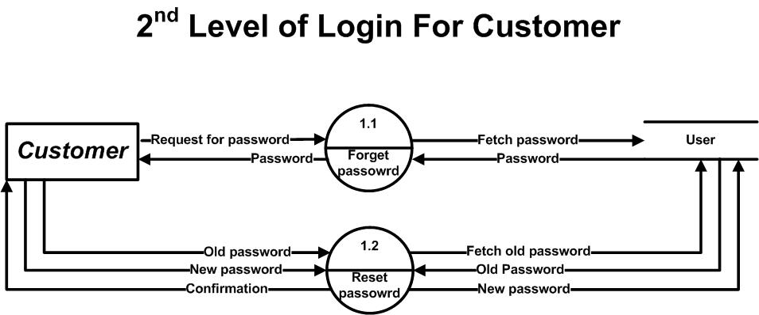
2nd level for login

Slide 28
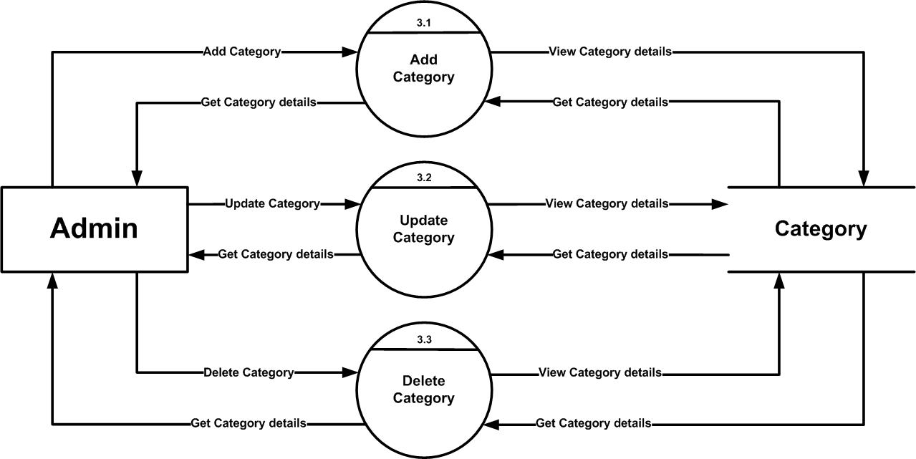
2nd level for category

Slide 29
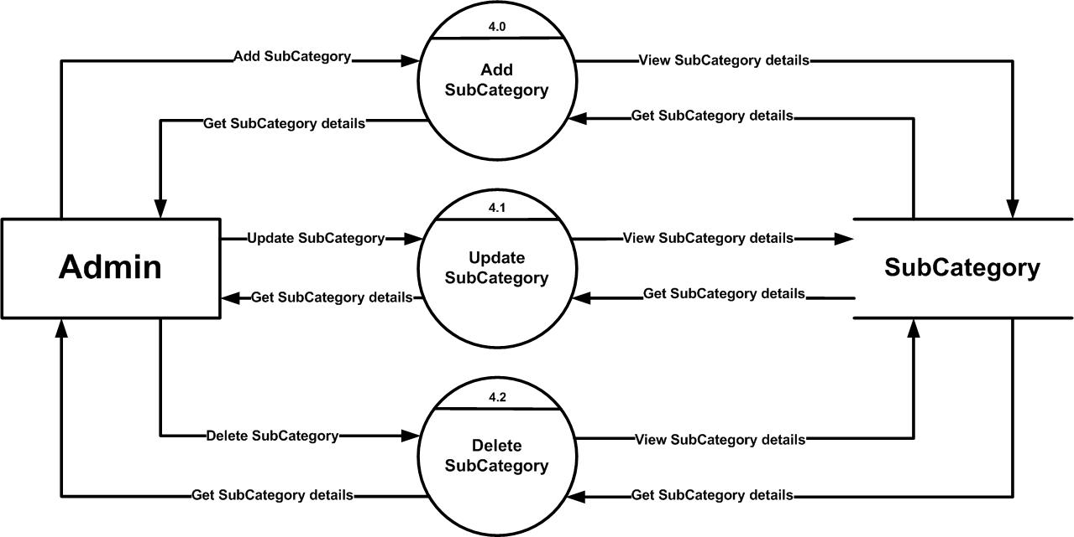
2nd level for sub-category

Slide 30

2nd level for product

Slide 31
2nd Level DFD for Customer

Slide 32
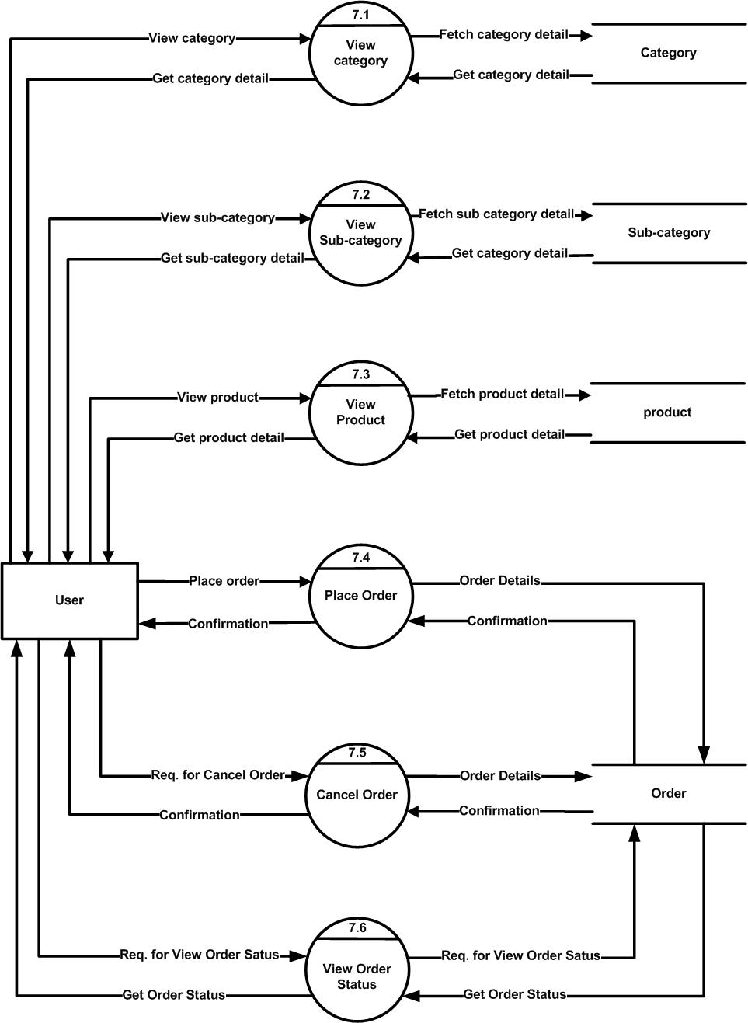
2nd level for Order

Slide 33
Entity relationship diagram

Slide 34
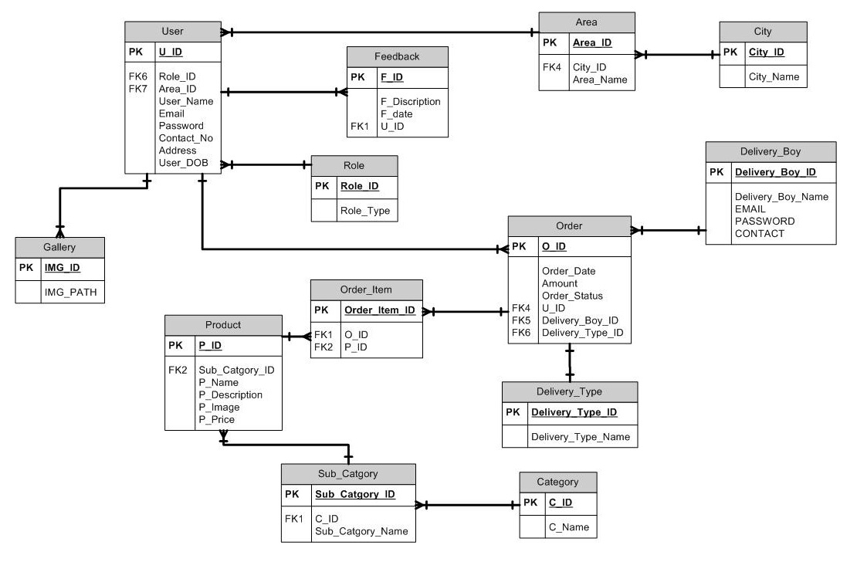

Slide 35
Data dictionary

Slide 36
Tables
User
Role
Gallary
Category
Sub_Category
Product
Order
Order_Item
Area
City
Feedback
Delivery_Boy
Delivery_Type

Slide 37
Table name : User Primary key : User_ID Forgein key : Role_ID, Area_ID
Sr. No | Column_name | Data Type | Constraint | Description
1 | User_ID | INT (3) | PK | Uniquly identify User
2 | Role_ID | INT (3) | FK | Reference to the Role
3 | Area_ID | INT(3) | FK | Reference to the Area
4 | User_Name | VARCHAR(30) | NOT NULL | Store UserName
5 | Email | VARCHAR(30) | NOT NULL | Store Email
6 | Password | VARCHAR(30) | NOT NULL | Store Password
7 | Contact_No | VARCHAR(13) | NOT NULL | Store Contact_no
8 | Address | VARCHAR(100) | NOT NULL | Store Address
9 | User_DOB | Date | NOT NULL | Store DOB

Slide 38
Table name : Role Primary key : Role_id
Sr.No | Column_name | Data Type | Constraint | Description
1 | Role_ID | INT (3) | PK | Uniquly identify role
2 | Role_Type | VARCHAR(100) | NOT NULL | Store Role Name

Slide 39
Table name : Gallery Primary key : IMG_ID
Sr.No | Column_name | Data Type | Constraint | Description
1 | IMG_ID | INT (3) | PK | Uniquly identify Image of the product
2 | IMG_PATH | VARCHAR(50) | NOT NULL | Store path of the Image

Slide 40
Table Name : Category Primary Key : Category_ID
Sr. No | Column_Name | Data type | Constraint | Description
1 | C_ID | INT (3) | PK | Uniquly Identify Category
2 | C_Name | VARCHAR(30) | NOT NULL | Store Category Name

Slide 41
Table Name : Sub_Category Primary Key : Sub_Category_ID Foreign Key : C_ID
Sr. No | Column_Name | Data type | Constraint | Description
1 | Sub_Catgory_ID | INT (3) | PK | Uniquly identify Sub_Catgory
2 | C_ID | INT (3) | FK | Reference to the Category
3 | Sub_Catgory_Name | VARCHAR(100) | NOT NULL | Store Sub-Category Name

Slide 42
Table name : Product Primary key : P_ID Forgein key : Sub_Catgory_ID
Sr. No | Column_name | Data_Type | Constraint | Description
1 | P_ID | INT (3) | PK | Uniquly identify Product
2 | Sub_Category_ID | INT (3) | FK | Reference to the Sub_category
3 | P_Name | VARCHAR(30) | NOT NULL | Store Product Name
4 | P_Description | VARCHAR(100) | NOT NULL | Store Product Details
5 | P_Image | VARCHAR(200) | NOT NULL | Store Image of Product
6 | P_Price | DECIMAL(8,2) | NOT NULL | Price of the product
7 | IsNewArrivel | INT(1) |  | Indicate that product is newly arriwal
8 | P_qty | INT(4) | NOT NULL | Store Product quantities

Slide 43
Table name : Order Primary key : O_ID Forgein key : U_ID, Delivery_Type, Delivery_Boy_ID, Order_Item_ID
Sr. No | Column_Name | Data_Type | Constraint | Description
1 | O_ID | INT (3) | PK | Uniquly identify Order
2 | U_ID | INT (3) | FK | Reference to the user
3 | Delivery_Boy_ID | INT (3) | FK | Reference to the Delivery_Boy
4 | Delivery_Type_ID | INT (3) | FK | Home delivery or pickup
5 | Order_Date | DATE | NOT NULL | Date of created order
6 | Amount | DECIMAL(8,2) | NOT NULL | Price of the Product
7 | Order_Status | VARCHAR(30) | NOT NULL | Delivered or Not

Slide 44
Table name : Order_Item Primary key : Order_Item_ID Forgein key : P_ID
Sr.No | Column_name | Data Type | Constraint | Description
1 | Order_Item_ID | INT (3) | PK | Uniquly identify Delivery_Boy ID
2 | P_ID | INT (3) | FK | Reference to the Product
3 | O_ID | INT(3) | FK | Reference to the Order
3 | Quantity | INT(3) | NOT NULL | Store the Quantity of the products

Slide 45
Table name : Area Primary key : Area_ID Forgein key : City_ID
Sr.No | Column_name | Data Type | Constraint | Description
1 | Area_ID | INT (3) | PK | Uniquly identify Area
2 | City_ID | INT(3) | FK | Reference to the City
3 | Area_Name | VARCHAR(30) | NOT NULL | Store Area Name

Slide 46
Table name : City Primary key : City_ID
Sr.No | Column_name | Data Type | Constraint | Description
1 | City_ID | INT (3) | PK | Uniquly identify City
2 | City_Name | VARCHAR(30) | NOT NULL | Store City Name

Slide 47
Table Name:-Feedback Primary Key:-F_ID Foreign Key : U_ID
Sr.No | Column_name | Data type | Constraint | Description
1 | F_ID | INT (3) | PK | Uniquly Identified Feedback
2 | U_ID | INT (3) | FK | References to the User
3 | F_Discription | VARCHAR(150) | NOT NULL | Store Feedback From Users
4 | F_date | DATE | NOT NULL | Store Date

Slide 48
Table name : Delivery_Boy Primary key : Delivery_Boy_ID
Sr.No | Column_name | Data Type | Constraint | Description
1 | Delivery_Boy_ID | INT (3) | PK | Uniquely identify Delivery_Boy ID
2 | Delivery_Boy_ Name | VARCHAR(30) | NOT NULL | Store Delivery Boy Name
3 | EMAIL | VARCHAR(30) | NOT NULL | Store Delivery Boy Email-ID
4 | PASSWORD | VARCHAR(30) | NOT NULL | Store Delivery Boy Password of Email-ID
5 | CONTACT | VARCHAR(13) | NOT NULL | Store Delivery Boy Contact Number

Slide 49
Table Name : Delivery_Type Primary Key : Delivery_Type_ID
Sr.No | Column_Name | Data type | Constraint | Description
1 | Delivery_Type_ ID | INT (3) | PK | Uniquly identify Delivery Type
2 | Delivery_Type_ Name | VARCHAR (30) | NOT NULL | Store Delivery Type

Slide 50
Bibliography
Books:
System Analysis and Designing
Author:Thomas j Cashman

Slide 51
THANK YOU

